Slide 1
RETAIL SALES PERFORMANCE DASHBOARD USING POWER BI
SUMBITTED BY :
EZHILARASI K
TEAM 1

Slide 2

INTRODUCTION
The Retail Sales Performance Dashboard is developed to analyze retail business data using Microsoft Power BI.
It provides a centralized platform to monitor sales, profit, orders, and customer performance.
The dashboard converts raw sales data into meaningful business insights through interactive visualizations.
It enables managers to identify high-performing products and profitable regions.
Interactive reports help users filter and analyze data quickly for better understanding.
This project demonstrates how Power BI supports business intelligence and data-driven decision-making.

Slide 3

OBJECTIVES
To import and analyze retail sales data in Power BI.
To clean and transform the dataset for accurate analysis.
To calculate important business KPIs using DAX measures.
To design an interactive dashboard with various charts and filters.
To identify sales trends, profitable products, and regional performance.
To provide meaningful insights that support effective business decisions.

Slide 4
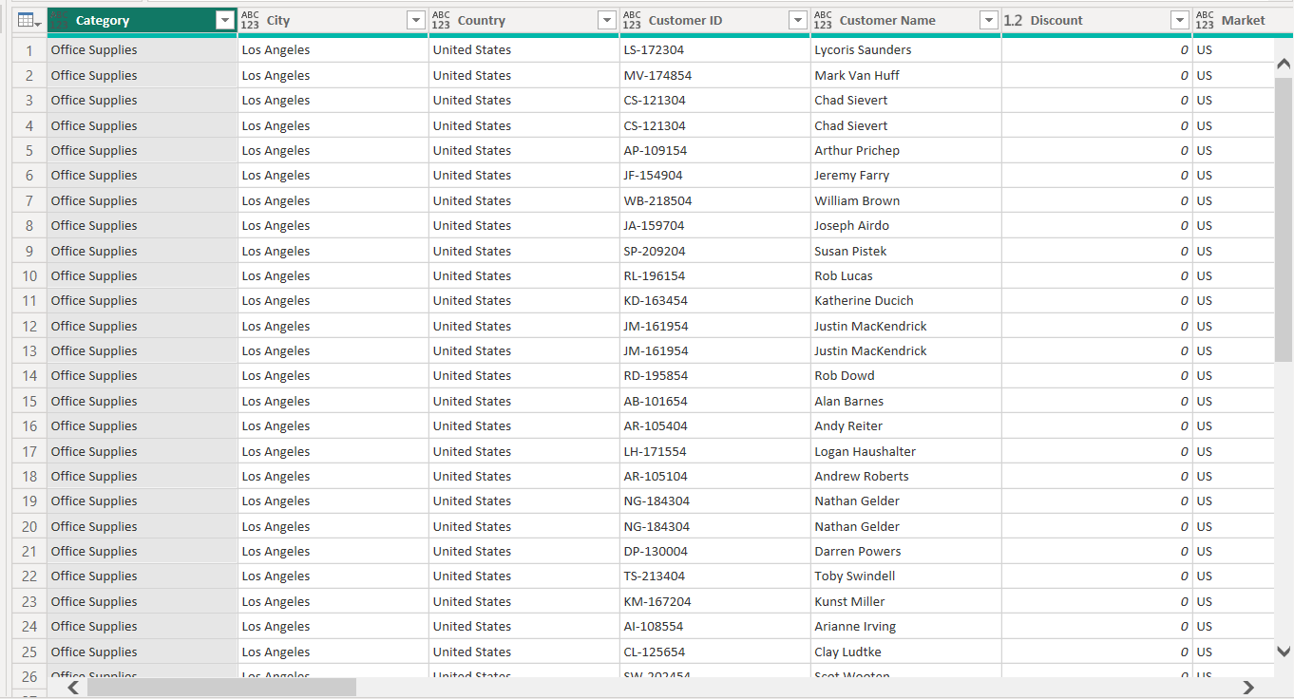
DATA SET DESCRIPTION
The project uses the Global Superstore retail sales dataset in Excel format.
The dataset contains customer, product, order, and sales transaction details.
Important fields include Order Date, Region, Category, Sales, Profit, Quantity, and Discount.
The dataset represents real-world retail business operations and transactions.
It provides sufficient information for creating sales and profit analytics.
The dataset is suitable for building professional Power BI dashboards.

Slide 5
DATA PREPROCESSING
Imported the Excel dataset into Microsoft Power BI Desktop.
Verified all column data types such as Date, Text, and Decimal Number.
Removed duplicate records to maintain data accuracy.
Checked and handled missing or null values wherever required.
Renamed columns for better readability and easier report development.
Loaded the cleaned dataset into Power BI for further analysis.
DATASET
CHECK/REMOVED
RENAMED
LOADED

Slide 6
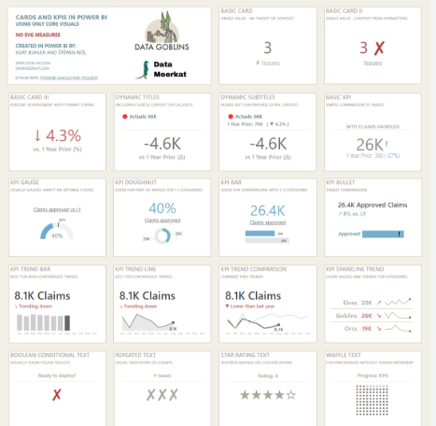
DAX MEASURES & KPI CARDS
Created Total Sales using the SUM() function.
Calculated Total Profit from the Profit column.
Counted Total Orders using DISTINCTCOUNT().
Calculated Profit Margin Percentage using the DIVIDE() function.
Created Total Quantity Sold to measure total product sales.
Displayed all measures using KPI Cards for a quick business summary.

Slide 7
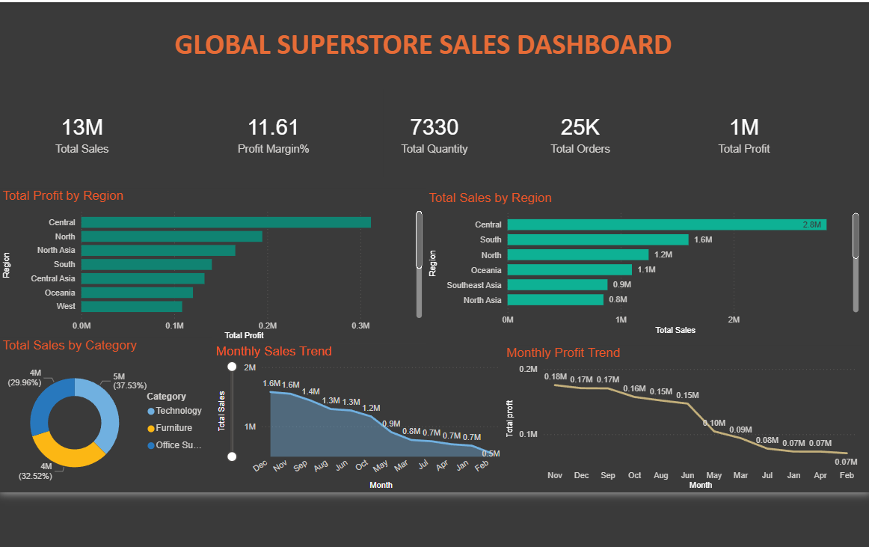
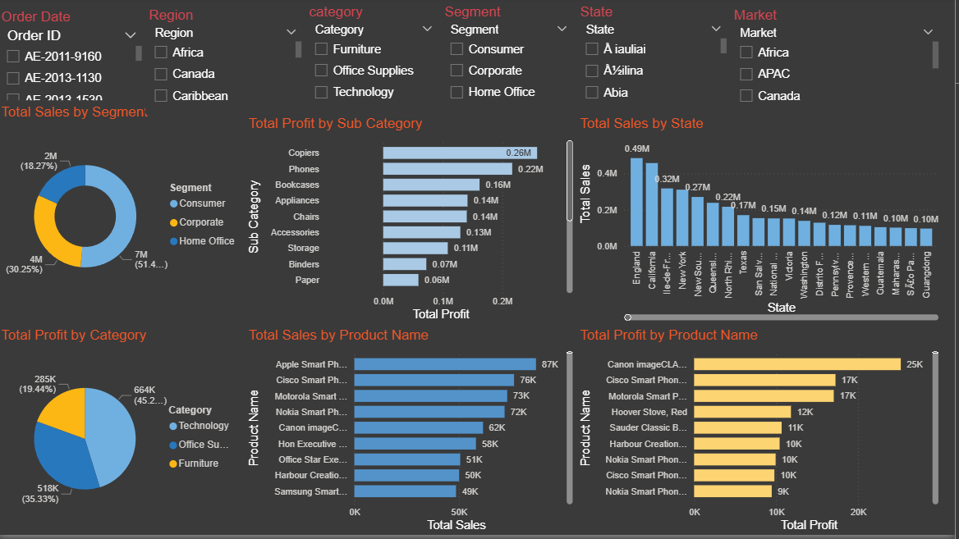
DASHBOARD VISUALIZATIONS
Line Chart to analyze monthly sales trends over time.
Clustered Bar Chart to compare sales across different regions.
Donut Chart to display sales contribution by product category.
Bar Chart to identify the Top 10 Best-Selling Products.
Bar Chart to compare profit across various sub-categories.
Filled Map to visualize sales performance across different states.

Slide 8
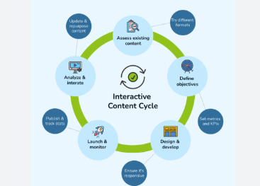
INTERACTIVE FEATURES
Added Order Date slicer to filter reports by selected time periods.
Added Region slicer to analyze regional business performance.
Added Category slicer to compare product categories.
Added Segment slicer to evaluate different customer groups.
Interactive filters update every chart instantly based on user selection.
These features improve dashboard usability and user experience.

Slide 9
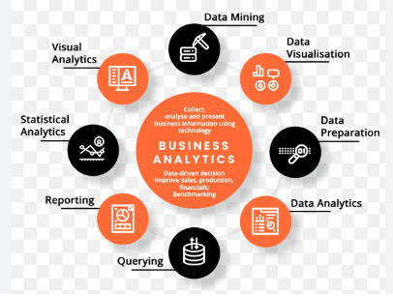
BUSINESS INSIGHTS
Technology products generated the highest overall sales revenue.
The West region contributed the maximum sales among all regions.
Consumer customers accounted for the largest share of sales.
Some product sub-categories recorded lower or negative profits.
Monthly sales analysis helped identify seasonal business trends.
The dashboard supports faster and more informed business decisions.

Slide 10
DASHBOARD OUTPUT
The dashboard displays all important KPIs on a single screen.
Interactive charts provide a comprehensive view of business performance.
Users can filter the report using slicers without modifying the data.
The dashboard presents sales, profit, products, and regional analysis together.
Business managers can quickly identify trends and improvement areas.
The final dashboard is simple, interactive, and easy to understand.

Slide 11

CONCLUSION
Successfully developed an interactive Retail Sales Dashboard using Power BI.
Cleaned and transformed retail sales data for accurate reporting.
Created DAX measures to calculate important business KPIs.
Designed interactive visualizations to analyze sales and profit performance.
Generated valuable business insights through dynamic reports and filters.
The project demonstrates how Power BI helps organizations make data-driven business decisions efficiently.

Slide 12

FUTURE ENHANCEMENTS
Integrate real-time sales data from online databases.
Add sales forecasting using Power BI forecasting features.
Develop customer churn and customer lifetime value analysis.
Create mobile-friendly dashboard versions for executives.
Connect the dashboard with cloud platforms for automatic updates.
Use AI-powered visuals and advanced analytics for deeper business insights.

